Slide 1



Web Services
SOAP & REST Web Services
www.supinfo.com
Copyright © SUPINFO. All rights reserved
Notes:
© SUPINFO International University - http://www.supinfo.com
SUPINFO vous permet de partager ce document
Vous êtes libre de :
Partager — reproduire, distribuer et communiquer ce document Remixer — modifier ce document
A condition de respecter les règles suivantes :
Indication obligatoire de la paternité — Vous devez obligatoirement préciser l’origine « SUPINFO » du document au début de celui-ci de la même manière qu’indiqué par SUPINFO International University – Notamment en laissant obligatoirement la première et la dernière page du document, mais pas d'une manière qui suggérerait que SUPINFO International University vous soutiennent ou approuvent votre utilisation du document, surtout si vous le modifiez. Dans ce dernier cas, il vous faudra obligatoirement supprimer le texte « SUPINFO Official Document » en tête de page et préciser notamment la page indiquant votre identité et les modifications principales apportées.
En dehors de ces dispositions, aucune autre modification de la première et de la dernière page du document n’est autorisée.
NOTE IMPORTANTE : Ce document est mis à disposition selon le contrat CC-BY-NC-SA Creative Commons disponible en ligne http://creativecommons.org/licenses ou par courrier postal à Creative Commons, 171 Second Street, Suite 300, San Francisco, California 94105, USA modifié en ce sens que la première et la dernière page du document ne peuvent être supprimées en cas de reproduction, distribution, communication ou modification. Vous pouvez donc reproduire, remixer, arranger et adapter ce document à des fins non commerciales tant que vous respectez les règles de paternité et que les nouveaux documents sont protégés selon des termes identiques. Les autorisations au-delà du champ de cette licence peuvent être obtenues à support@supinfo.com.
© SUPINFO International University – EDUCINVEST - Rue Ducale, 29 - 1000 Brussels Belgium . www.supinfo.com

Slide 2


Course objectives
Web Services
By completing this course, you will be able to :
Describe what Web Services are
Explain how work SOAP Web Services
Design SOAP Web Services
Explain how work REST Web Services
Design REST Web Services

Slide 3

Course topics
Web Services
Course’s plan
HTTP Reminders
Introduction to Web Services
SOAP Web Services
SOAP Web Services with JAX-WS
Consume a Web Service with JAX-WS
RESTful Web Services
RESTful Web Services with JAX-RS
JAX-RS with JAXB

Slide 4
HTTP Reminders
Web Services

Slide 5


The Protocol
HTTP Reminders
HyperText Transfer Protocol
Communications protocol developed for the Web
Request/Response protocol
Data transfer between a browser and a Web server
Stateless
Notes:
The HTTP protocol (HyperText Transfer Protocol), is a communication protocol client/server created for the Web. HTTP is use to transmit resources between clients (the Web browser) and the HTTP server (or Web server).

Slide 6
Request Message
HTTP Reminders
Composed of :
A request line composed of :
The request method used
The resource URI
The protocol and the version used
Headers
An empty line
An optional message body

Slide 7
Request Message
HTTP Reminders
POST /en/html/index.html HTTP/1.1
Host: www.website.com
User-Agent: Mozilla/5.0 (Windows;en-GB; rv:1.8.0.11)
Accept: text/xml,text/html;q=0.9,text/plain;q=0.8,image/png,*/*;q=0.5
Accept-Language: en-gb,en;q=0.5
Accept-Encoding: gzip,deflate
Accept-Charset: ISO-8859-1,utf-8;q=0.7,*;q=0.7
Keep-Alive: 300
Connection: keep-alive
Content-Type: application/x-www-form-urlencoded
Content-Length: 39
name=MyName&male=yes

Slide 8
Request Methods
HTTP Reminders
HTTP defines nine methods (or verbs) :
GET : Request a representation of the resource
POST : Submit data to be processed to the identified resource
This may result in the creation of a new resource
PUT : Uploads a representation of the specified resource
DELETE : Deletes the specified resource
…

Slide 9
Response Status Codes
HTTP Reminders
Status codes are divided into five classes :
1xx : Informational
Indicates a provisional response
2xx : Success
Indicates the request was received, understood, accepted and processed successfully
Examples :
200 OK
201 Created

Slide 10
Response Status Codes
HTTP Reminders
Status codes are divided into five classes :
3xx : Redirection
Indicates that further action needs to be taken by the user agent in order to fulfill the request
Example :
301 Moved Permanently

Slide 11
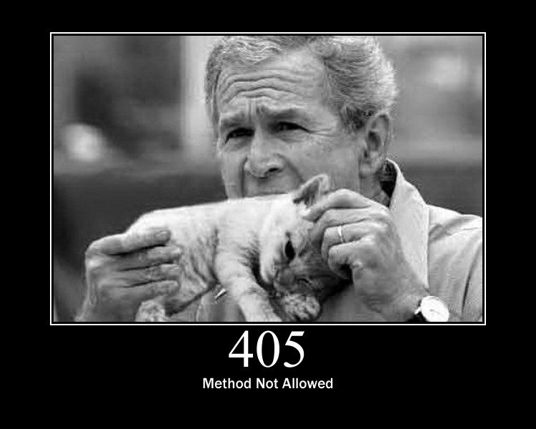
Response Status Codes
HTTP Reminders
Status codes are divided into five classes :
4xx : Client Error
Intended for cases in which the client seems to have erred
Examples :
403 Forbidden
404 Not Found
405 Method Not Allowed

Slide 12
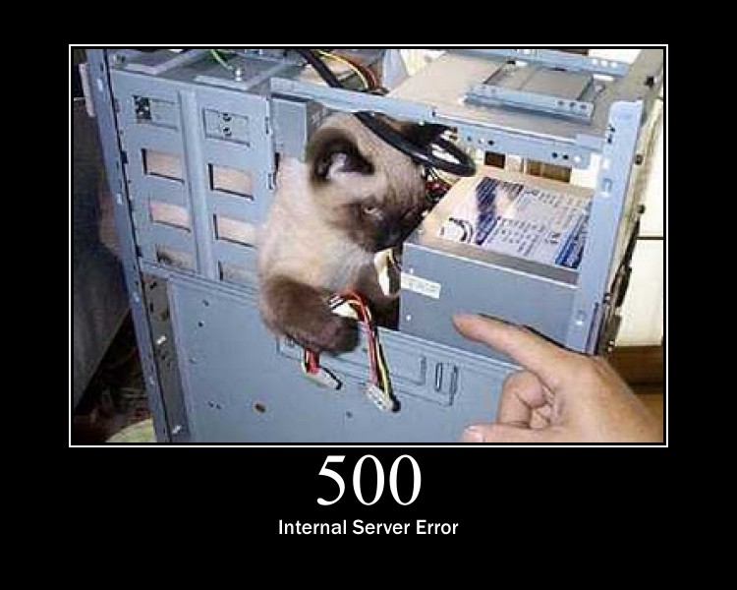
Response Status Codes
HTTP Reminders
Status codes are divided into five classes :
5xx : Server Error
Indicate the server is aware that it has encountered an error or is otherwise incapable of performing the request
Examples :
500 Internal Server Error
501 Not Implemented
502 Bad Gateway

Slide 13



Stop-and-think
HTTP Reminders
Do you have any questions ?
???

Slide 14
Introduction to Web Services
Web Services

Slide 15
Definition
Introduction to Web Services
A Web Service is a software system that allows communication between two electronic devices over the web
Shared logic/data but don’t provide GUI
Designed to be used by other applications !
Example:
Twitter clients use Twitter Web Services to retrieve/post tweets
Two most famous types of Web Services are :
REST Web Services (also called Web API)
SOAP Web Services (also called Big Web Services)

Slide 16
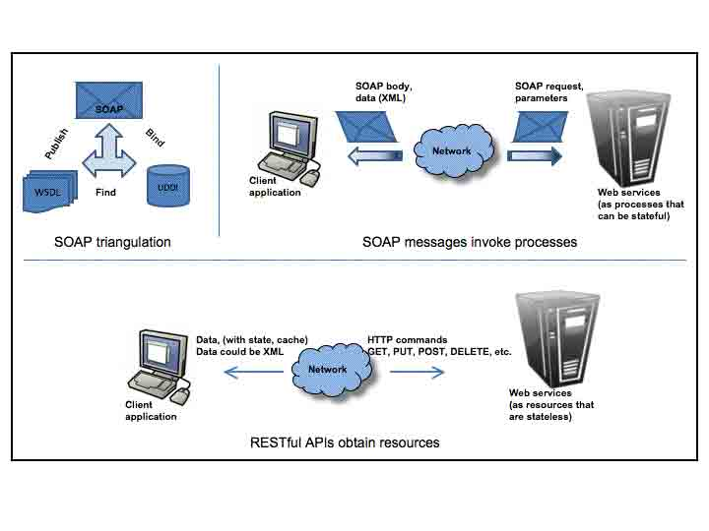
SOAP vs REST
Introduction to Web Services

Slide 17
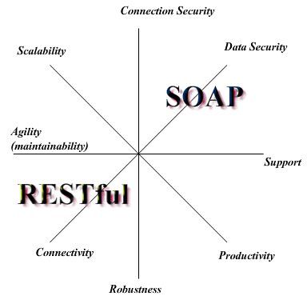
SOAP vs REST
Introduction to Web Services

Slide 18
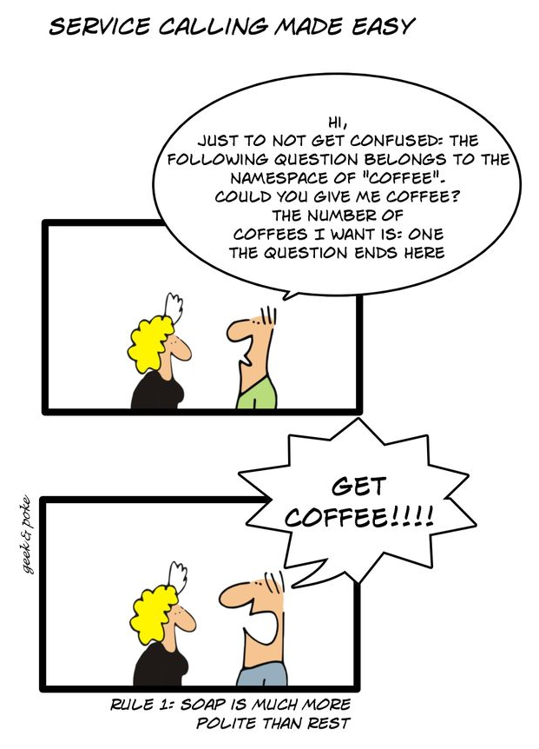
SOAP vs REST by Geek & Poke
Introduction to Web Services

Slide 19
Stop-and-think
Introduction to Web Services
Do you have any questions ?
???

Slide 20
SOAP Web Services
Web Services

Slide 21

Presentation
SOAP Web Services
SOAP means Simple Object Access Protocol
RPC protocol based on XML
Allow messages transmission between two remote object
Remote Procedure Call !
Usually used with HTTP but can be used with other protocols (SMTP, …)
Notes:
Parler plus de la WSDL.
Retrouver graphique comparatif entre REST et SOAP.

Slide 22
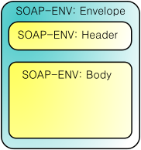
SOAP Envelope
SOAP Web Services
SOAP messages are composed of two parts :
A Header (optional)
A Body
Both parts are inside a SOAP Envelope

Slide 23
SOAP Message Examples
SOAP Web Services
Method signature :
SOAP Request :
int doubleAnInteger ( int numberToDouble );
<?xml version="1.0" encoding="UTF-8" standalone="no" ?>
<SOAP-ENV:Envelope xmlns: ... >
<SOAP-ENV:Body>
<ns1:doubleAnInteger xmlns:ns1="urn:MySoapServices">
<param1 xsi:type="xsd:int">123</param1>
</ns1:doubleAnInteger>
</SOAP-ENV:Body>
</SOAP-ENV:Envelope>

Slide 24
SOAP Message Examples
SOAP Web Services
SOAP Response :
<?xml version="1.0" encoding="UTF-8" standalone="no" ?>
<SOAP-ENV:Envelope
xmlns:SOAP-ENV="http://schemas.xmlsoap.org/soap/envelope/"
xmlns:xsd="http://www.w3.org/1999/XMLSchema">
<SOAP-ENV:Body>
<ns1:doubleAnIntegerResponse
xmlns:ns1="urn:MySoapServices"
SOAP-ENV:encodingStyle=
"http://schemas.xmlsoap.org/soap/encoding/">
<return xsi:type="xsd:int">246</return>
</ns1:doubleAnIntegerResponse>
</SOAP-ENV:Body>
</SOAP-ENV:Envelope>

Slide 25
SOAP Message Examples
SOAP Web Services
SOAP headers are not used in the previous examples
They are optional !
Used for authentication or session management
<soap:Envelope xmlns:soap="...">
<soap:Header>
<UsernameToken xmlns="http://abc.com/webservices">
user
</UsernameToken>
<PasswordText xmlns="http://abc.com/webservices">
hello123
</PasswordText>
</soap:Header>
<soap:Body><!-- data goes here --></soap:Body>
</soap:Envelope>

Slide 26
WSDL
SOAP Web Services
How a client can know about procedure he can call ?
Thanks to WSDL !
Web Services Description Language is an XML format for describing network services as a set of endpoints operating on messages containing either document-oriented or procedure-oriented information
It thus serves a roughly similar purpose as a Method signature in a programming language

Slide 27
WSDL
SOAP Web Services
WSDL Structure:
<definitions>
<types> <!-- The data types used by the web service --> </types> <message> <!-- The messages used by the web service -->
</message> <portType> <!-- The operations performed by the web service -->
</portType> <binding> <!-- The communication protocols used by the web service -->
</binding> </definitions>

Slide 28
WSDL
SOAP Web Services
WSDL Port Types
Describes a web service, the operations that can be performed, and the messages that are involved
Can be compared to a function library in a programming language
WSDL Messages
Define the data elements of an operation
Can be compared to the parameters of a function call in a programming language
Notes:
Abréger…

Slide 29
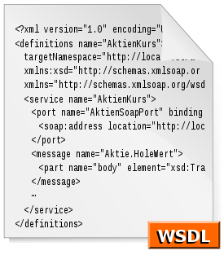
WSDL
SOAP Web Services
WSDL Types
Define the data types that are used by the web service
WSDL Bindings
Define the message format and protocol details for each port
Notes:
Abréger…

Slide 30
Stop-and-think
SOAP Web Services
Do you have any questions ?
???

Slide 31
SOAP Web Services with JAX-WS
Web Services

Slide 32
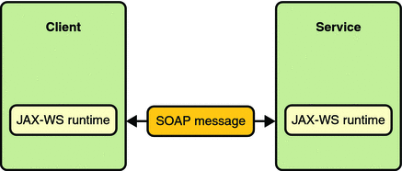
Presentation
SOAP Web Services with JAX-WS
JAX-WS is an API that can be used :
In server side to define Web Services
In client side to consume Web Services
SOAP Web Services are interoperable !
So you can use JAX-WS to consume a Web Service develop in another technology

Slide 33
Presentation
SOAP Web Services with JAX-WS
JAX-WS API is very easy :
Just need to write the desired service…
… enhanced by annotations ! (again)
No need to handle how the SOAP response will be written
Just concentrate on the business rules !
We’re going to see the main annotations JAX-WS provides…

Slide 34
Develop a Web Service
SOAP Web Services with JAX-WS
To define a Web Service, just use the @WebService annotation !
@WebService
public class CircleFunctions {
public double getArea(double r) {
return java.lang.Math.PI * (r * r);
}
public double getCircumference(double r) {
return 2 * java.lang.Math.PI * r;
}
}

Slide 35
Develop a Web Service
SOAP Web Services with JAX-WS
@WebService annotation can have some attributes :
name: The name of the Web Service
serviceName: The service name of the Web Service
wsdlLocation: The location of a pre-defined WSDL describing the service
…
@WebService ( name="MyWebService", serviceName="UsefulService", targetNamespace="http://ws.supinfo.com/sample" )
public class MyWebService {
...
}

Slide 36
Develop a Web Service
SOAP Web Services with JAX-WS
JAX-WS also provides a @WebMethod annotation to customize the Web Service methods :
This annotation can have several attributes :
operationName :
Name of the wsdl:operation matching this method
exclude :
If true, marks that method to NOT be exposed
@WebMethod(operationName="computeArea")
public double getArea(double r) {
return java.lang.Math.PI * (r * r);
}

Slide 37
Develop a Web Service
SOAP Web Services with JAX-WS
JAX-WS also provides a @WebParam annotation to customize the Web Service parameters :
This annotation can have several attributes :
header :
If true, the parameter is pulled from a message header rather then the message body
name :
Name of the parameter
…
@WebMethod(operationName="computeArea")
public double getArea(@WebParam(name="num1")double r) {
return java.lang.Math.PI * (r * r);
}

Slide 38
Generate WSDL
SOAP Web Services with JAX-WS
But how to generate the WSDL file based on that services ?
JAX-WS do it for you !
Available at that URL :
http://<host>/<context-path>/<service-name>?WSDL
Look at the WSDL file of our CircleFunctions Web Service !

Slide 39
JAX-WS – Server side
SOAP Web Services with JAX-WS
When the application will be deployed, these files will be generated on the server:
The WSDL from the Web Services classes
The JAXB classes for Entities//XML data-binding delegation
JAX-WS use JAXB to marshal or unmarshal the payload between java object and XML document
We’ll see JAXB later…

Slide 40
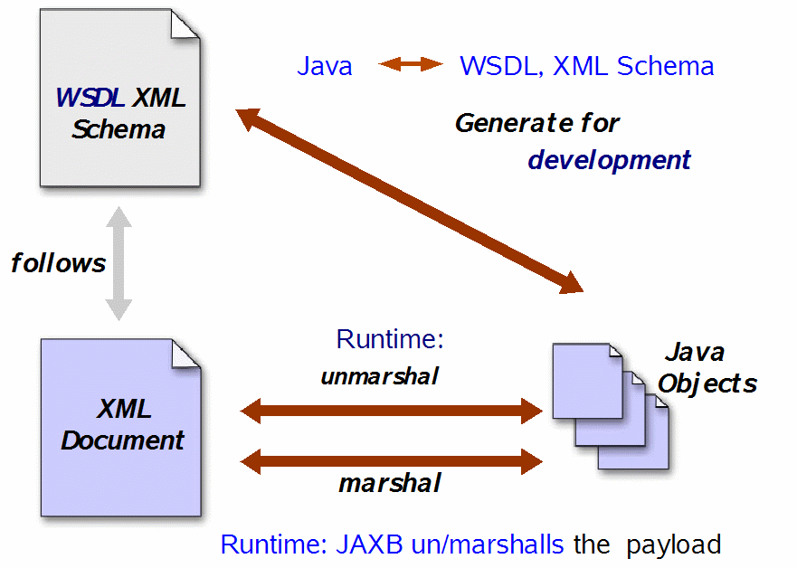
JAX-WS – Server side
SOAP Web Services with JAX-WS

Slide 41
Other annotations
SOAP Web Services with JAX-WS
JAX-WS support other annotations to customize and control even more the result of the Web Service :
@WebResult
@SOAPBinding
@BindingType
Etc…
See http://jax-ws.java.net/jax-ws-ea3/docs/annotations.html for more information

Slide 42

Deployment
SOAP Web Services with JAX-WS
Glassfish allows you to see and test your Web Services method by giving you a ready-to-use Web Client
Simply enter the Web Service URL followed by ?Tester
For example:
http://localhost:8080/MyWebService/Calculator?Tester
Notes:
http://docs.oracle.com/javaee/6/tutorial/doc/bnayn.html

Slide 43
Stop-and-think
SOAP Web Services with JAX-WS
Do you have any questions ?
???

Slide 44

Exercise
SOAP Web Services with JAX-WS
SupRails wants to provide Web Services to allow some partners to use their Trip information
These partners are only able to consume SOAP Web Services
So you choose to use JAX-WS ☺
You have to provide two services :
Retrieve all the available Trips in SupRails Database
Process a customer order for a trip
Use the Glassfish Tester to see if it works

Slide 45
Consume a Web Service with JAX-WS
Web Services

Slide 46
Presentation
Consume a Web Service with JAX-WS
We have seen how to create a Web Service with JAX-WS
But how to consume it from another application ?
JAX-WS can be used to do that too !
Remember, JAX-WS can be used to consume all SOAP Web Services, whatever the language used to develop them !
All what you need is :
The WSDL location
The JAX-WS libraries

Slide 47
wsimport
Consume a Web Service with JAX-WS
But how to consume a Web Services without the classes that it used ?
Model objects for example…
Remember, all the services and their data types are defined inside the WSDL !
So JAX-WS provide you a simple CLI tool to generate Java classes you need with the WSDL :
wsimport -s src -d bin http://localhost:8080/webservice/ClaculatorService?wsdl
Notes:
wsimport is a simple command line tool you can used to generate java classes from a WSDL.
The -s option specify where you want put the generated sources and the -d where you want to put the compiled classes.

Slide 48
Retrieve the service class
Consume a Web Service with JAX-WS
To retrieve the Web Service class, you just need to use the following code :
Where WSDL_LOCATION is the URL to the WSDL and SERVICE_QNAME the namespace URI followed by the service name
private MyWebService getMyWebService() {
try {
URL wsdlLocation = URI.create(WSDL_LOCATION).toURL();
QName serviceName = QName.valueOf(SERVICE_QNAME);
Service service = Service.create(wsdlLocation,serviceName);
return service.getPort(MyWebService.class);
} catch (MalformedURLException e) {
throw new IllegalStateException(e);
}
}
Notes:
Example of QNAME is {http://service.simplesoapexample.supinfo.com/}PostServiceService

Slide 49
Stop-and-think
Consume a Web Service with JAX-WS
Do you have any questions ?
???

Slide 50
Exercise
Consume a Web Service with JAX-WS
SupRails need an example application which consumes your Web Services
This application will be shown to the partners to prove that your Web Services work well
Create a simple Java console Application :
It must be able to display all the available trips and process an order
Use your Web Services to do that ☺

Slide 51
RESTful Web Services
Web Services

Slide 52
What is REST ?
RESTful Web Services
The term comes from Roy Fielding’s doctoral dissertation
REpresentational State Transfer
He defines a RESTful system with the following constraints :
It must be a client-server system
It has to be stateless
It has to support a caching system
It has to be uniformly accessible
It has to be layered (support scalability)
The static web is RESTful by default, not the dynamic one

Slide 53
Resources
RESTful Web Services
A RESTful resources is anything that is addressable over the Web
Resource examples are :
The temperature in Paris at 8:00 PM
A blog post
A list of Bug Reports inside a BTS
A search result in Google
Notes:
BTS: Bug Tracking System

Slide 54
Representation
RESTful Web Services
A Representation is typically a document that captures the current or intended state of a resource
It’s what is sent back and forth between clients and servers
Can take various form such as :
One resource can have more than one representation
HTML Document
Plain Text
XML Stream
JSON Stream
…

Slide 55
RESTful Web Services
RESTful Web Services
Also called RESTful web API, it’s a simple web service implemented using HTTP and the principles of REST
The URI of a resource is a hyperlink
The HTTP protocol provides methods on which we can map CRUD operations
And so apply different actions with the same URI !
Data action | HTTP protocol equivalent
CREATE | POST
RETRIEVE | GET
UPDATE | PUT
DELETE | DELETE

Slide 56

A simple RESTful example
RESTful Web Services
Example of RESTful Web Services with JAX-RS are available at the following URL :
http://restful-example.appspot.com/
It provides CRUD operations on a student list
We’ll use them as example in the course

Slide 57
GET / Retrieve
RESTful Web Services
The method GET is used to RETRIEVE resources
For instance, a GET request to the URI /students return all the students :
<students>
<count>2</count>
<student>
<birthDate>5287-09-15T22:00:13.524Z</birthDate>
<firstName>Jack</firstName>
<idBooster>59253</idBooster>
<lastName>Harkness</lastName>
</student>
<student>
<birthDate>1997-08-12T22:00:13.524Z</birthDate>
<firstName>Eric</firstName>
<idBooster>64543</idBooster>
<lastName>Cartman</lastName>
</student>
</students>

Slide 58

GET / Retrieve
RESTful Web Services
And a GET request to the URI /students/59253 returns Jack :
<student>
<birthDate>5287-09-15T22:00:13.524Z</birthDate>
<firstName>Jack</firstName>
<idBooster>59253</idBooster>
<lastName>Harkness</lastName>
</student>

Slide 59
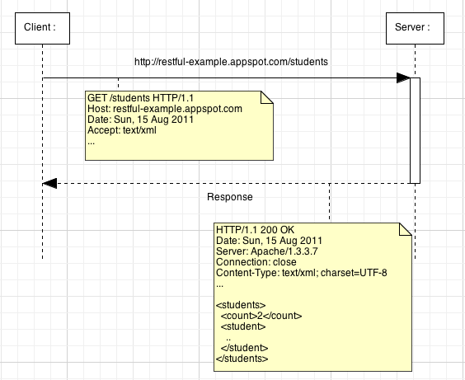
GET / Retrieve
RESTful Web Services
Let’s have a look at the request details :

Slide 60
POST / Create
RESTful Web Services
The method POST is used to CREATE resources
For instance, assume Joe doesn’t exist in our list and we want to add him :
A Joe XML representation looks like this :
<student>
<birthDate>1946-06-28T22:00:13.524Z</birthDate>
<firstName>Joe</firstName>
<idBooster>65442</idBooster>
<lastName>Dalton</lastName>
</student>

Slide 61
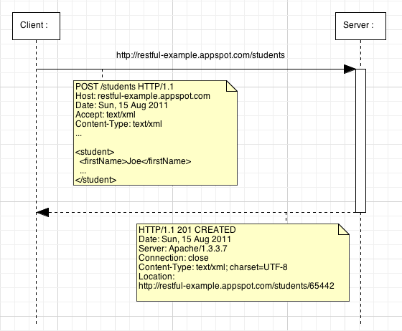
POST / Create
RESTful Web Services
Let’s have a look at the request details :
Notes:
The response of a POST request can contain a body but in that example we prefer use the 201 status code with a Location header with the new resource URI.

Slide 62
PUT / Update
RESTful Web Services
The method PUT is used to UPDATE resources
For instance, assume Joe representation is currently like that :
We want update him to be like this :
<student>
<birthDate>1946-06-28T22:00:13.524Z</birthDate>
<firstName>Joe</firstName>
<idBooster>65442</idBooster>
<lastName>Dalton</lastName>
</student>
<student>
<birthDate>1946-06-28T22:00:13.524Z</birthDate>
<firstName>Joeffrey</firstName>
<idBooster>65442</idBooster>
<lastName>Dalton</lastName>
</student>

Slide 63
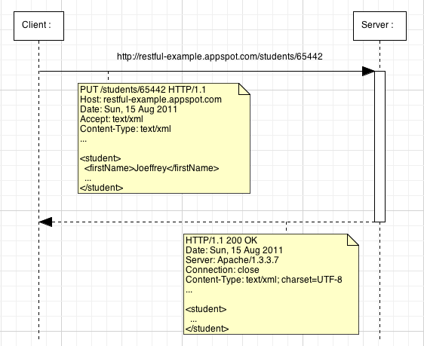
PUT / Update
RESTful Web Services
Let’s have a look at the request details :

Slide 64
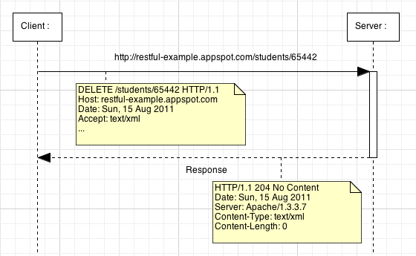
DELETE / Delete
RESTful Web Services
The method DELETE is used to DELETE resources
Let’s have a look at the request details :

Slide 65
Stop-and-think
RESTful Web Services
Do you have any questions ?
???

Slide 66
RESTful Architectures
Demonstration
Let’s see if the RESTful Web Services of http://restful-example.appspot.com/ work well !
Notes:
[Title of the course]
Nov 8, 2008
Copyright © 2004-2005 NameOfTheOrganization. All rights reserved.
66

Slide 67
RESTful Web Services with JAX-RS
Web Services

Slide 68
Presentation
RESTful Web Services with JAX-RS
JAX-RS is one of the Java EE specifications
A dedicated API to design REST Web Services !
As all Java EE specifications, more than one implementations are available :
Apache CXF, an open source Web Service framework
Jersey, the reference implementation from Sun / Oracle
RESTEasy, JBoss's implementation
For this course, we’ll use Jersey !
Libraries are available here : http://jersey.dev.java.net

Slide 69

Presentation
RESTful Web Services with JAX-RS
JAX-RS API objective is to make RESTful Web Service development very easy :
Just need to develop POJO (Plain Old Java Object)…
… enhanced by annotations !
No need to handle HTTP request at low level
Just concentrate on the business rules !
We’re going to see the main annotations JAX-RS provides…

Slide 70
Installation
RESTful Web Services with JAX-RS
To use JAX-RS, you have to :
Include libraries in your project
Define the Jersey Servlet in the Deployment Descriptor :
<servlet>
<servlet-name>Jersey Web Application</servlet-name>
<servlet-class>
com.sun.jersey.spi.container.servlet.ServletContainer
</servlet-class>
<init-param>
<param-name>
com.sun.jersey.config.property.packages
</param-name>
<param-value>com.supinfo.restfulexample.rest</param-value>
</init-param>
</servlet>
<servlet-mapping>
<servlet-name>Jersey Web Application</servlet-name>
<url-pattern>/resources/*</url-pattern>
</servlet-mapping>
Notes:
The init-param com.sun.jersey.config.property.packages define the package containing your JAX-RS Resource classes.
The servlet-mapping define for which url pattern Jersey have to do something.

Slide 71
Resource URI
RESTful Web Services with JAX-RS
A JAX-RS resource is a Java class with the @Path annotation to define his URI
Example :
This annotation can also be used to define variables in URIs :
We’ll see later how to retrieve the value of those variables
@Path("/students")
public class StudentsResource {
...
}
@Path("/students/{idBooster}")
public class StudentsResource {
...
}

Slide 72
HTTP methods
RESTful Web Services with JAX-RS
To determine which Java method to call in function of the HTTP method request, JAX-RS provide four annotations :
@GET
@POST
@PUT
@DELETE
Example :
@Path("/students")
public class StudentsResource {
@GET
public String handleGetRequest() { ... }
@POST
public String handlePostRequest(String payload) { ... }
}

Slide 73
HTTP methods
RESTful Web Services with JAX-RS
POST and PUT methods handler can have a payload parameter representing the request’s body data
Payloads can have several types in function of the Content-Type request header :
Java Type | Content Type Supported
java.lang.String | */*
byte[] | */*
java.io.InputStream | */*
java.io.Reader | */*
javax.ws.rs.core. MultivaluedMap<String, String> | application/x-www-form-urlencoded
JAXB classes | text/xml, application/xml, application/json
Notes:
We’ll see JAXB classes later…

Slide 74
Relative paths in methods
RESTful Web Services with JAX-RS
In some cases it may be useful to define two Java methods associated with two different URI in a same class
You can do that declaring @Path annotation on a method !
Example :
In that case, a GET request on /students/search/Jack will execute the searchStudent() method
@Path("/students")
public class StudentsResource {
@GET
public String getStudentList() { ... }
@GET @Path("/search/{query}")
public String searchStudent() { ... }
}

Slide 75
URI variables
RESTful Web Services with JAX-RS
We saw how to define variables with @Path annotation in previous slides…
… but no how to retrieve them inside a Java method
To do that, JAX-RS define a @PathParam annotation
You can use it as follow :
@GET @Path("/{idBooster}")
public String getStudent(@PathParam("idBooster") Long id) {
...
}
@GET @Path("/search/{query}")
public String searchStudent(@PathParam("query") String q) {
...
}

Slide 76
Input formats
RESTful Web Services with JAX-RS
We can define which method to call in function of the Content-Type HTTP header of the client request thanks to :
@Consumes annotation
Example :
@Path("/students")
public class StudentResource {
@POST @Consumes(MediaType.APPLICATION_XML)
public String addXmlStudent(String payload) { ... }
@POST @Consumes(MediaType.APPLICATION_JSON)
public String addJsonStudent(String payload) { ... }
}

Slide 77
Output formats
RESTful Web Services with JAX-RS
We can define which method to call in function of the Accept HTTP header of the client request thanks to :
@Produces annotation
Example :
@Path("/students")
public class StudentResource {
@GET @Produces(MediaType.APPLICATION_XML)
public String getStudentAsXml() { ... }
@GET @Produces(MediaType.APPLICATION_JSON)
public String getStudentAsJson() { ... }
}

Slide 78
Stop-and-think
RESTful Web Services with JAX-RS
Do you have any questions ?
???

Slide 79
JAX-RS with JAXB
Web Services

Slide 80
Presentation
JAX-RS with JAXB
JAXB for Java Architecture for XML Binding
Allow to map Java classes to XML representations
Two main features are :
Marshal Java objects into XML
Unmarshal XML into Java objects
Very useful for Web Services !
This course isn’t about all the JAXB features
We’re going to see only one part in order to make REST Web Services development easier !

Slide 81

JAX-RS and JAXB support
JAX-RS with JAXB
Jersey provides a very helpful integration of JAXB including the following features :
Serialize Java objects as JSON document
Unserialize JSON document into Java objects
Automatic Unserialization of resource method payloads
No more need to define one method by consume type !
Automatic Serialization of resource method results
No more need to define one method by produce type !

Slide 82
JAX-RS and JAXB support
JAX-RS with JAXB
Example :
@Path("/students")
public class StudentResource {
@GET @Path("/{idBooster}")
public Student getStudent(@PathParm("idBooster") Long id) {
Student student = ... ; //Retrieve Student in DB
return student;
}
@POST
public Response addStudent(Student student) {
... ; //Add the student in DB
String studentUri = "/" + student.getIdBooster();
return Response.created(URI.create(studentUri)).build();
}
}

Slide 83

Annotations
JAX-RS with JAXB
Since JAXB2, you can map a Java class just with annotations ! (yeah, annotations again…)
We’re going to see the main ones :
@XmlRootElement
@XmlElement
@XmlAttribute
@

Slide 84
XmlRootElement
JAX-RS with JAXB
Maps a class or an enum type to an XML top-level element
By default the name of the XML element is the same than the class name
But you can change it thanks to the name attribute of the annotation
Example :
@XmlRootElement(name="doc")
public class Document {
}

Slide 85
XmlElement
JAX-RS with JAXB
Maps a JavaBean property to an XML element derived from property name
This annotation is optionnal
Three annotation attributes are available :
name : the name of the XML element
required : specify if the element is optional or nillable
defaultValue : default value of this element
Example :
@XmlElement(name = ”first-name", required = true)
private String firstName;

Slide 86
XmlAttribute
JAX-RS with JAXB
Maps a JavaBean property to an XML attribute
Two annotation attributes are available :
name : the name of the XML element
required : specify if the element is optional or nillable
Example :
@XmlAttribute
private int score;

Slide 87
Examples
JAX-RS with JAXB
@XmlRootElement
public class User {
private String username;
private String firstName;
private String lastName;
// Getters and Setters
}
<?xml version="1.0" encoding="UTF-8" standalone="yes"?>
<xs:schema version="1.0" xmlns:xs="...">
<xs:element name="user" type="user"/>
<xs:complexType name="user">
<xs:sequence>
<xs:element name="firstName" type="xs:string" minOccurs="0"/>
<xs:element name="lastName" type="xs:string" minOccurs="0"/>
<xs:element name="username" type="xs:string" minOccurs="0"/>
</xs:sequence>
</xs:complexType>
</xs:schema>

Slide 88
Examples
JAX-RS with JAXB
@XmlRootElement
public class User {
// Attributes
@XmlAttribute(name="id-booster")
public Long getIdBooster() { return idBooster; }
@XmlElement(name="first-name")
public String getFirstName() { return firstName; }
@XmlElement(name="last-name")
public String getLastName() { return lastName; }
// Setters
}

Slide 89
Examples
JAX-RS with JAXB
<?xml version="1.0" encoding="UTF-8" standalone="yes"?>
<xs:schema version="1.0" xmlns:xs="...">
<xs:element name="user" type="user"/>
<xs:complexType name="user">
<xs:sequence>
<xs:element name="first-name" type="xs:string" minOccurs="0"/>
<xs:element name="last-name" type="xs:string" minOccurs="0"/>
</xs:sequence>
<xs:attribute name="id-booster" type="xs:long"/>
</xs:complexType>
</xs:schema>

Slide 90
Stop-and-think
JAX-RS with JAXB
Do you have any questions ?
???

Slide 91
Exercise
JAX-RS with JAXB
SupRails wants to provide some Web API to developers who wants to use their information
A good way to have mobile applications developed by others for example ☺
You have to provide the following services :
Retrieve all the trips
Retrieve all the train stations
Add a new train stations
Process an order
Use JAX-RS to do that !

Slide 92

Course summary
Web Services
SOAP over HTTP
JAX-WS API
Web Services
JAX-RS API
Use JAXB
REST over HTTP

Slide 93


The end
Web Services

